Slide 1
Uncontrolled copy not subject to amendment
Basic Navigation Using Map and Compass

Slide 2
Basic Navigation Using Map and Compass
Learning Outcome 5:
Be able to recognise weather conditions that affect land navigation

Slide 3
Hot and Cold Air Masses

Slide 4
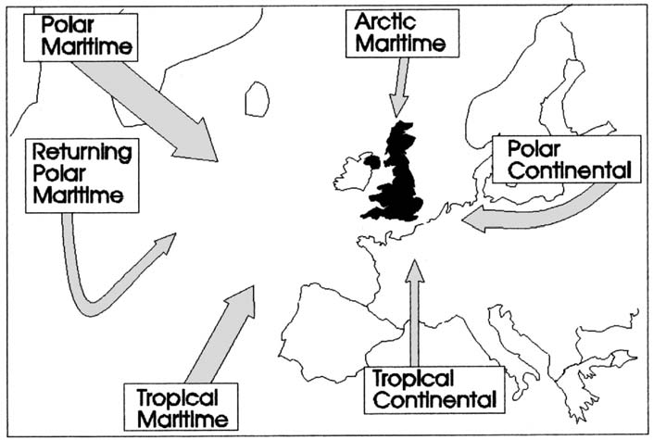
Main Air Masses
Width of the arrows indicates the frequency of occurrence

Slide 5
Weather Map

Slide 6
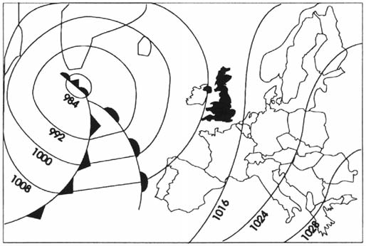
Fronts and Frontal Depressions
Numbers refer to pressure in millibars

Slide 7
Weather Map – Westerly Winds

Slide 8
Depression Chart

Slide 9
Depression

Slide 10
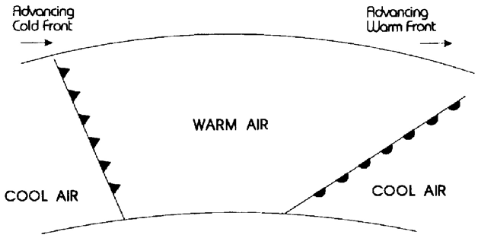
Fronts and Frontal Depressions
Section through a frontal system
Cold front is steeper than the warm front

Slide 11
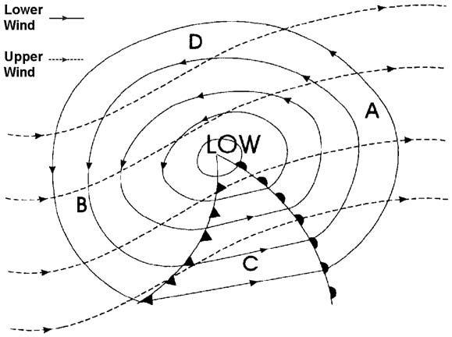
Upper Winds
Weather map showing isobars for both upper and lower winds

Slide 12
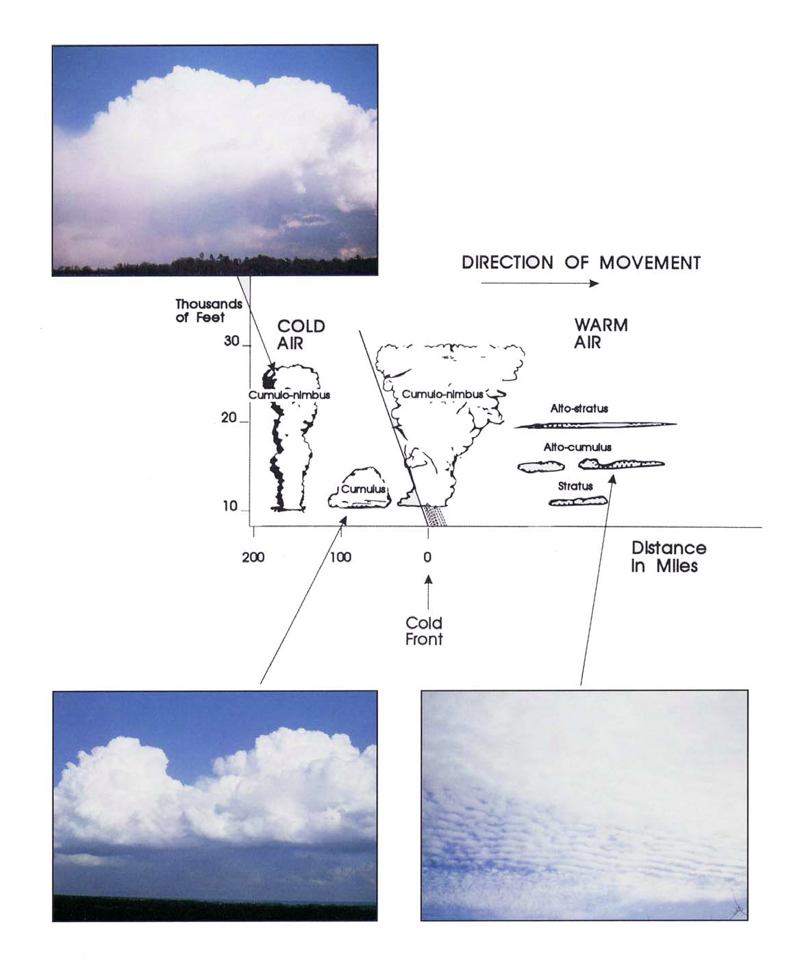

Slide 13
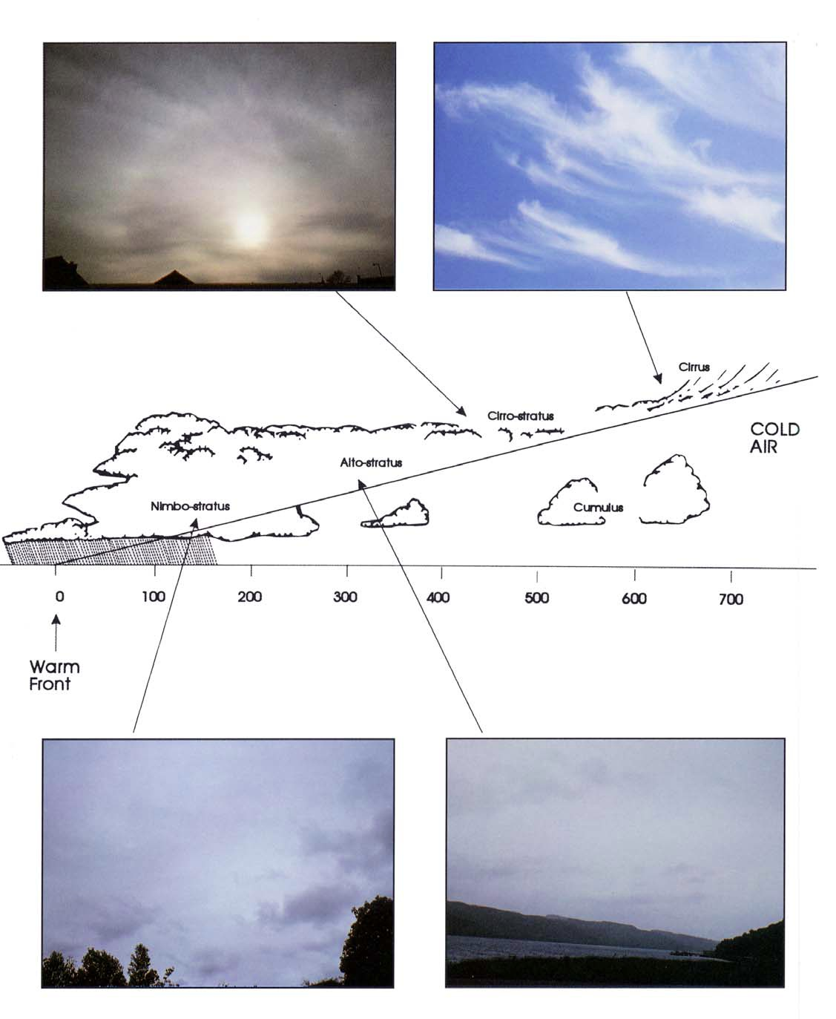

Slide 14
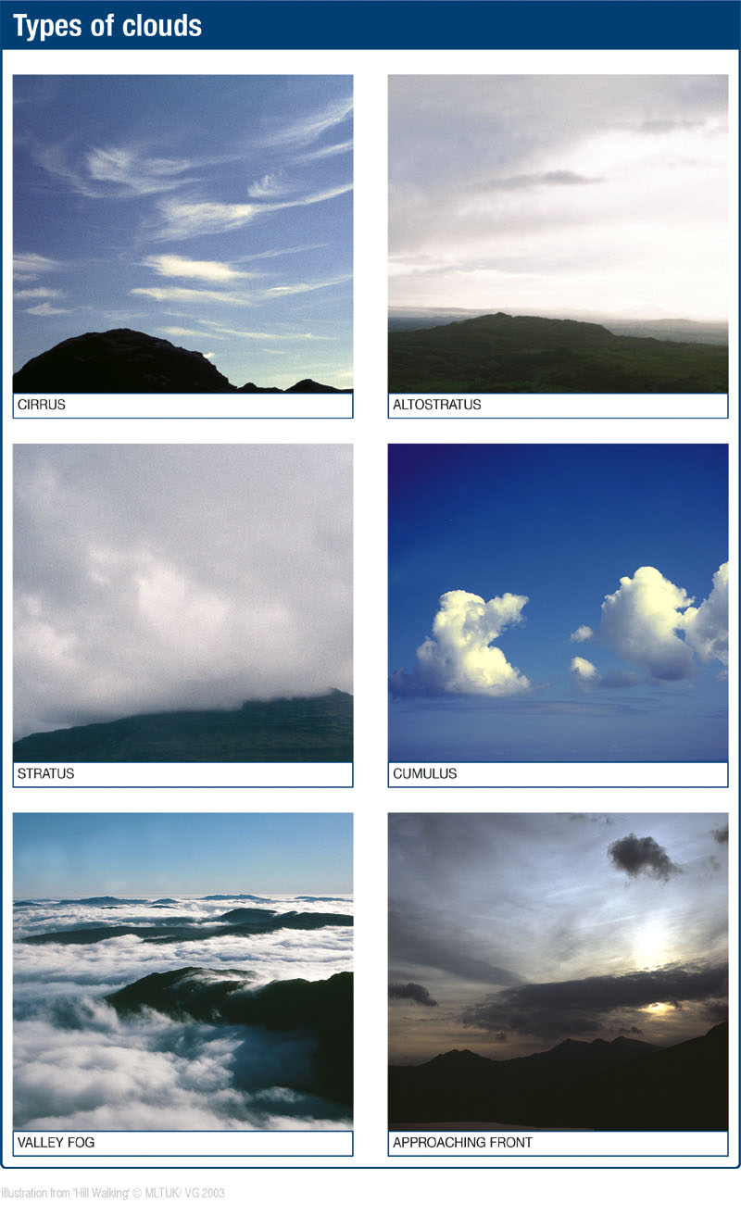

Slide 15
Local Warming

Slide 16
High and Low Pressure

Slide 17
Approaching Rain

Slide 18
Depression X Section

Slide 19
Warm Front

Slide 20
Cold Front

Slide 21
Occluded Front

Slide 22
Pockets of Air

Slide 23
Thermals above

Slide 24
Air rising over mountains

Slide 25
Rising Air Dewpoint

Slide 26
Cloudy foothills

Slide 27
High and Low Pressure

Slide 28
Funnels and Eddies

Slide 29
Banner Clouds

Slide 30
Temperature Inversion

Slide 31
Cross Section

